Slide 1
Hello!

Slide 2
Notes:
Good morning everyone, as Mr McLoughlin has just said we are the Anti-Bullying ambassadors. My name is Chloe and in a short while Clare-Rose and Joel are going to speak to you too. There are more than three of us. In fact there are 14 altogether, you can see the other 11 on the screen now.

Slide 3
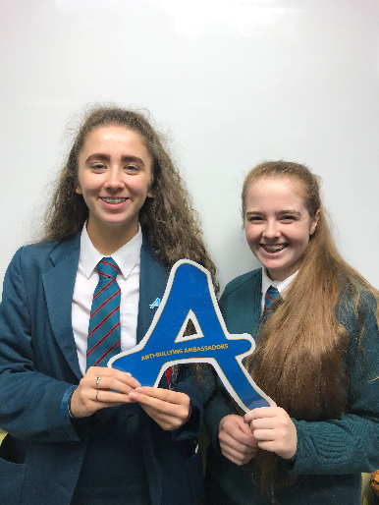
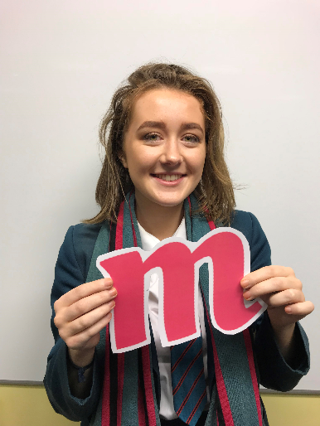
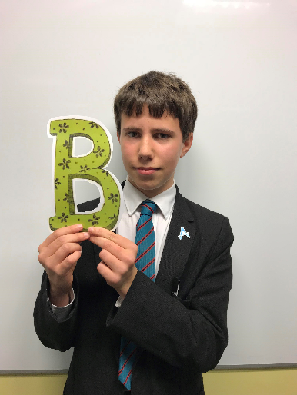
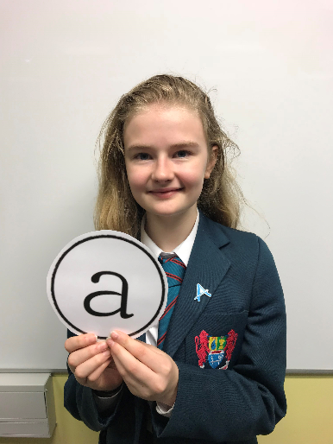
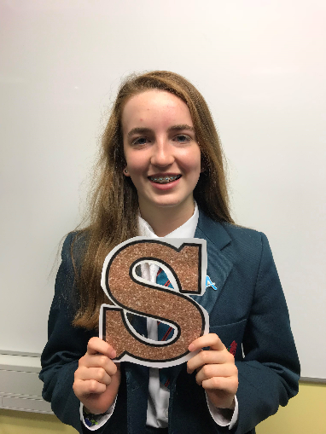
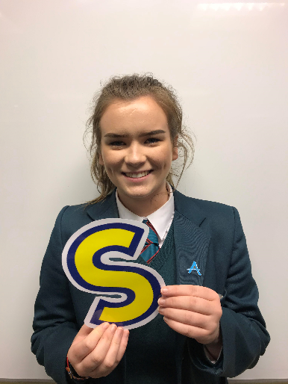
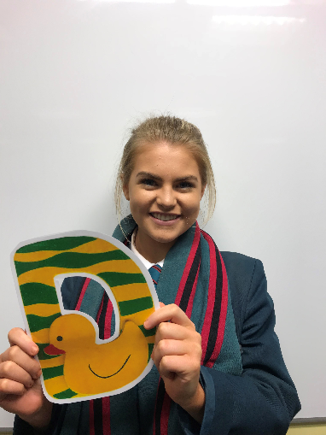
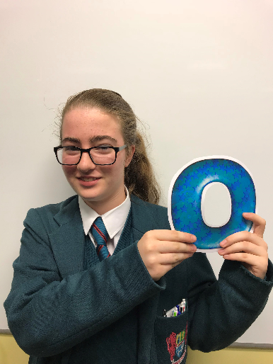
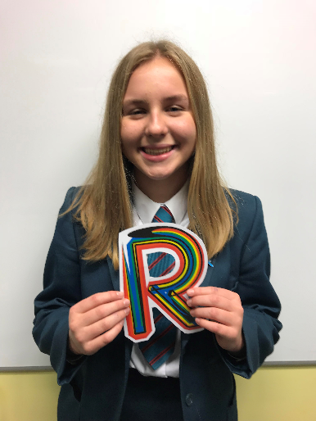
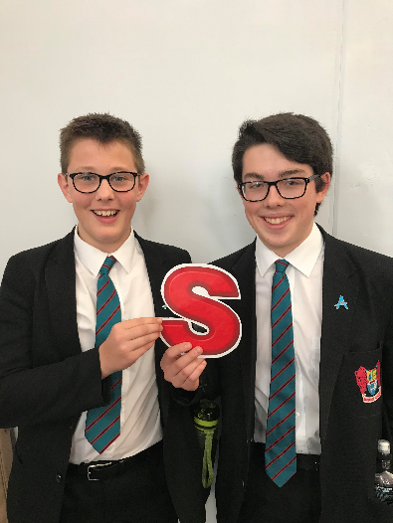
Who we are?
Notes:
We are a group of 14 people from years 9 to 14. An ABA is basically just somebody as the name suggests that is against bullying. We believe that the best way in order to tackle bullying in our school is through a student led approach. We hope to be a voice that is a little less scary than going to a teacher to report that you are being bullied.

Slide 4
What is bullying?
“Repeated negative behaviour that is intended to make others feel upset, uncomfortable or unsafe.”
VERBAL
Hurtful words, offensive language, swearing, discriminatory language
INDIRECT
Isolating someone, rumours, Cyber-bullying, damaging/taking someone’s property and physical intimidation.
PHYSICAL
Hurting someone intentionally, kicking,
Punching, pinching,
Spitting, slapping.
Notes:
So, what is bullying? Bullying is “Repeated negative behaviour that is intended to make others feel upset, uncomfortable or unsafe.” There are 3 different types of bullying; Verbal, Indirect and Physical. Verbal bullying includes hurtful words, offensive language and swearing. Indirect bullying includes leaving someone out, rumours and cyber-bullying. Physical bullying includes punching, slapping and hurting someone intentionally.

Slide 5
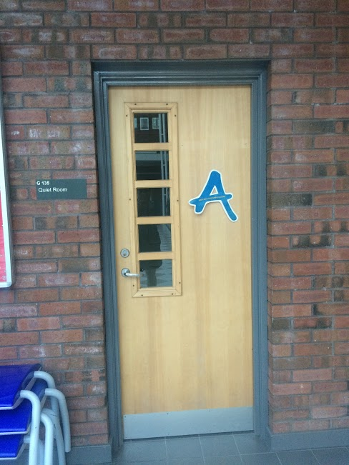
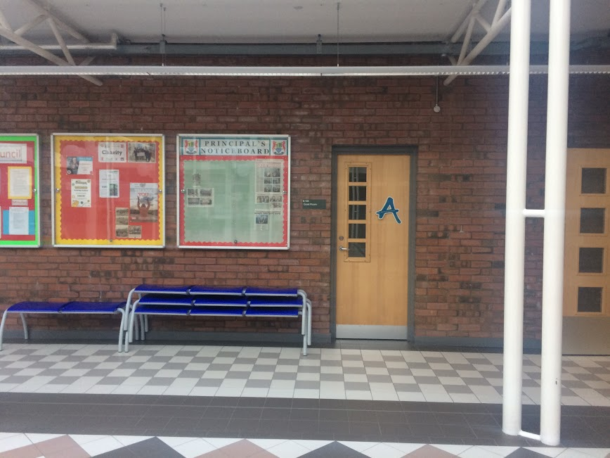
Chat room
At Friday lunchtime
Notes:
P2: So what actually are we going to do to try and prevent bullying or help someone who is being bullied? Well, we are opening up a chat room and not some strange online thing where we are always told to avoid, but rather in the quiet room on Friday lunchtime. It’s not anything formal just something you can come along to and meet new friends. You can come along for support or to give us ideas for ABA. Throughout the year we are also planning to run different events, but as yet we have nothing finalised. We are not here as some sort of counselling service. We ourselves are only students who are trying to help in instances of bullying, so you need not be afraid in coming to chat, we don’t bite. We want this to be informal, a simple chat is sometimes all it takes, a bit of advice to help you.

Slide 6
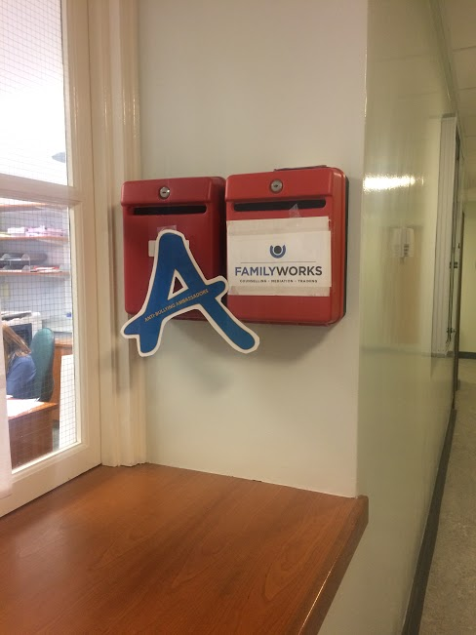
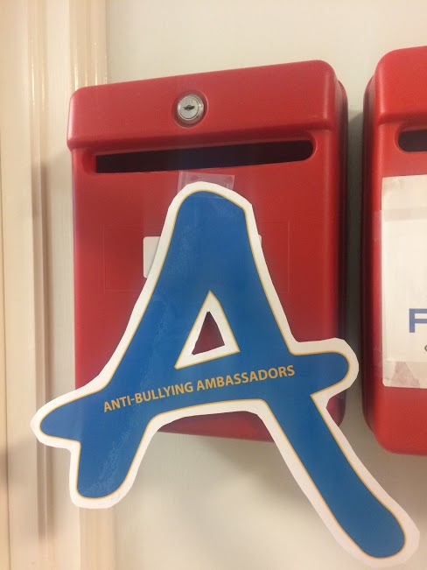
Notes:
You can speak to an ABA at any time, if you see us in the corridor and would like a chat just say so and we would be happy to help, we can be seen by our blue A badge. You can also get in contact with us at our new box at the hatch, if you or if you know of someone who you think we could help. You just need to write your name, your form class and a brief description of the issue on a piece of paper .

Slide 7
Video
Notes:
P3 : We are also here to talk to you a bit about AB week, which is this week. The theme this year is that we are all different but all equal and together the ABA have came up with a short video of how we believe that everyone can be an ambassador against bullying this week. We hope you enjoy.

Slide 8
Notes:
This week also keep an eye out for our new noticeboard as well, which is at the hatch. There you can see who the ABA are and also what we are getting up to within the school. We do hope that you will take our message on board about bullying this week and indeed in the future too. Bullying can happen anywhere to anyone, it doesn’t pick or choose its victims but it is not something that will be tolerated in our school. Make a difference this week- realise that we are all different but all equal, and make sure that to treat each other with the respect you would expect.

